Slide 1
Cereal Box Hero
Comparing Model-Free Reinforcement Learning Approaches in Maze Solving

Slide 2



Goal: Solve a 9x9 Maze
9x9 maze images generated using Kruskal’s algorithm

Slide 3

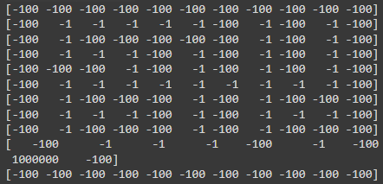
Maze Analysis and Representation
Apply grayscale
Maze represented as a reward matrix (Walls: -100, Path: -1, End: 10000)

Slide 4
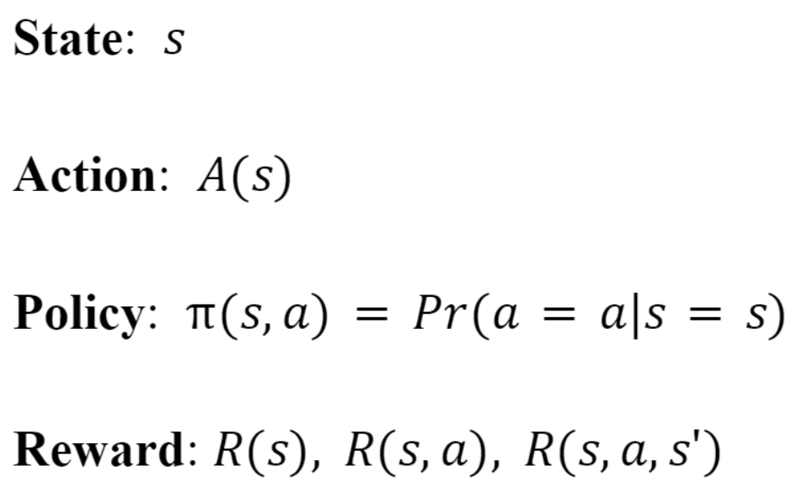
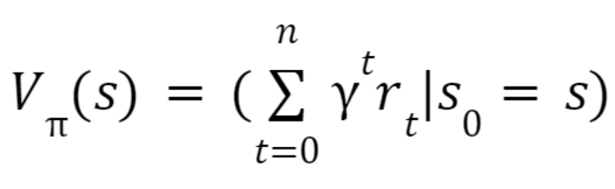
Reinforcement Learning
Markov Decision Process
Value Function
Used to optimize policy to increase reward size or frequency
Discount rate
Reward

Slide 5
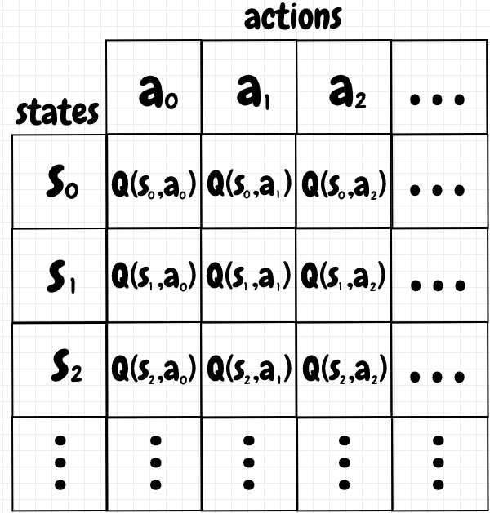
Model-Free Reinforcement Learning
No pre-built model of environment
Measures and stores “quality” of a state/action pair based on a value function
Better rewards → higher q-values
Often based on either Temporal Difference (TD) or Gradient-Based Learning methods

Slide 6
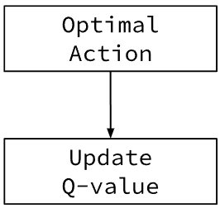
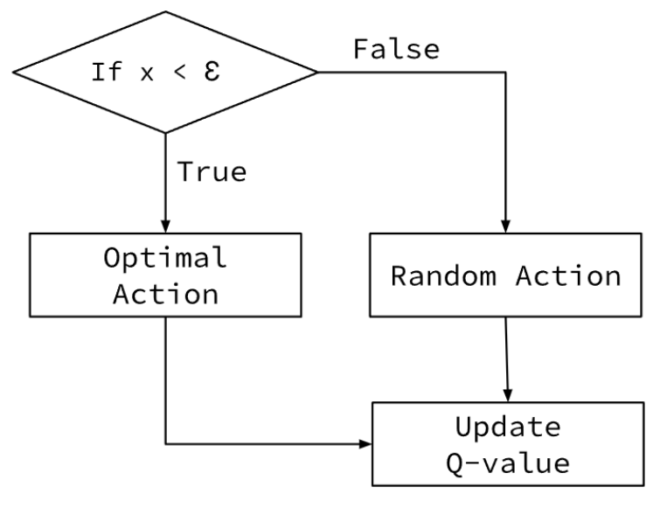
Model-Free Reinforcement Learning
Q-Learning
“Quality” Learning
Can use ON, OFF, or HYBRID policy using an Epsilon-greedy function
SARSA
“State Action Reward State Action”
Always ON policy
*Both methods based on TD-learning*...

Slide 7
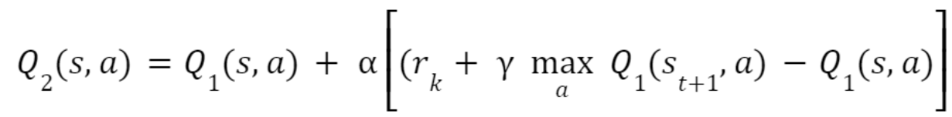
Temporal Difference Learning (TD-Learning) Function:
Q-Learning Function:
Learning rate

Slide 8
Q-Learning Function:
SARSA Function:
Discount factor
Max. next Q-value (despite off-policy)
Updated
Q-Value
Old
Q-Value
Learning rate
Reward (sometimes off-policy)
Max. next Q-value (on-policy)
Reward (on-policy)

Slide 9
Training Phase
Start at random location/state on the path
Move up, down, right, or left, depending on largest Q-value for given location
Q-Learning: 10% of the time, a random action is chosen
SARSA: Optimal action is always chosen
Update last Q-value depending on whether or not the move was on path
Repeat 1-3 if last action was on path
Continue until Q-tables converge upon an optimal solution!

Slide 10
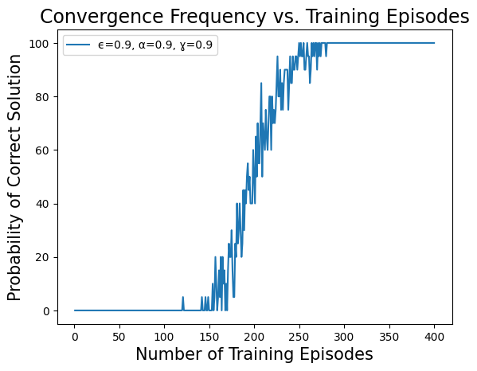
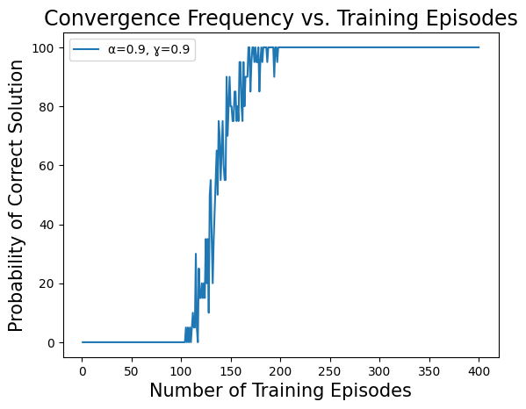
Q-Learning
SARSA

Slide 11
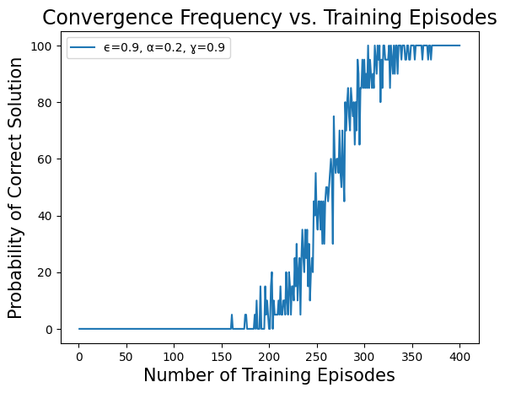
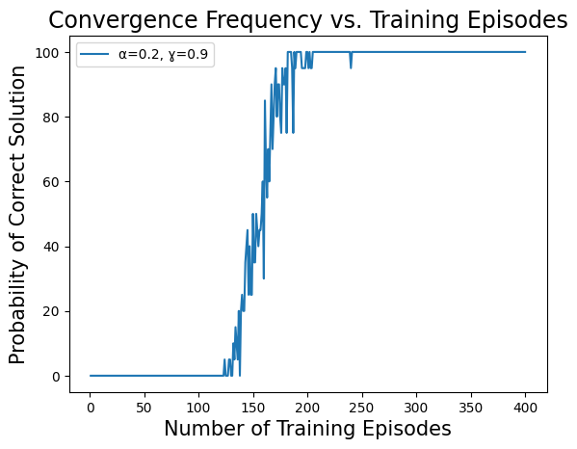
Q-Learning
SARSA

Slide 12
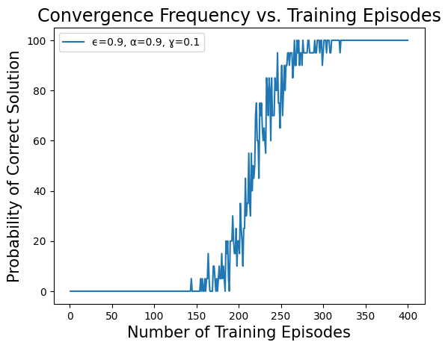
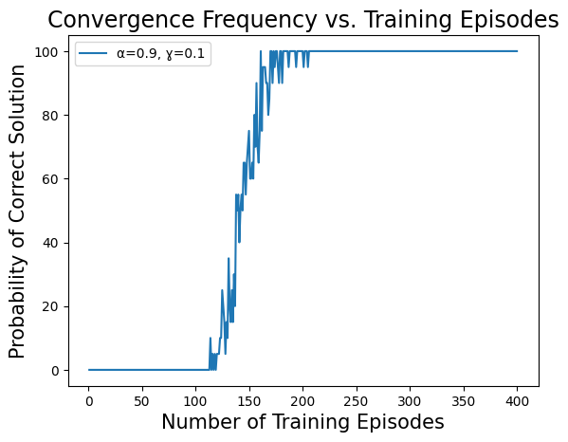
Q-Learning
SARSA

Slide 13
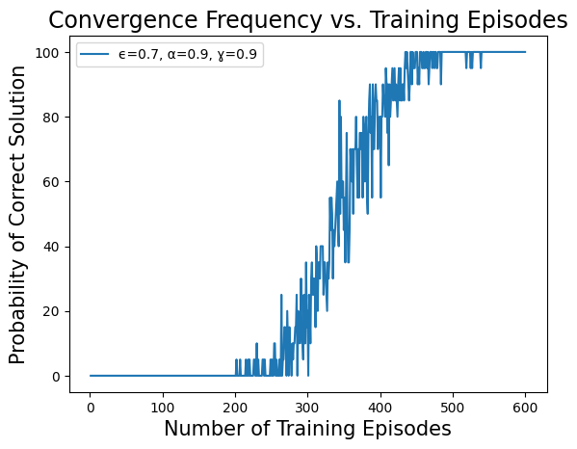
*Epsilon change not applicable*
Q-Learning
SARSA

Slide 14
Notes on Model-Free Reinforcement Learning
Q-learning is more widely applied than SARSA
Deep reinforcement Q-learning
Gradient-based algorithms can be applied to continuous action spaces
Surpassed human expert control in video games
Frameworks are becoming more lightweight
Some algorithms combine value-based and policy-based approaches
Actor-critic methods combine TD-learning and policy gradients

